Slide 1
Class 6

Slide 2

Do The Following
Turn video on
Type in chat or say:
My favorite time of day is
___ ______
3. Click when done

Slide 3
Logistics
Project proposals due 10/1
A2 due 10/4

Slide 4
DB seminar talks
9/29 Julia Stoyanovich (NYU)
Responsible Data Management
10/13 Wolfgang Gatterbauer (Northeastern)
QueryVis
10/20 Kostas Karanasos (Microsoft Gray Labs)
Lab overview + In-db ML inference
10/27 Vasiliki Kalavri (Boston U)
Streaming Research
11/10 Aaron Elmore (UChicago)
CrocodileDB
Zoom link in slack

Slide 5
Breakout Questions (different for each group!)
Group 1: Writing
Group 2: Technical Contributions
Group 3: Experiment
Group 4: Future

Slide 6
Class 5

Slide 7
Do The Following
Turn video on
Type in chat or say:
My favorite time of day is
___ ______
3. Click when done

Slide 8
Logistics
Today: multi-machine joins
A2 is out – optimizer!
A1 – what did you learn? What did you already know?

Slide 9
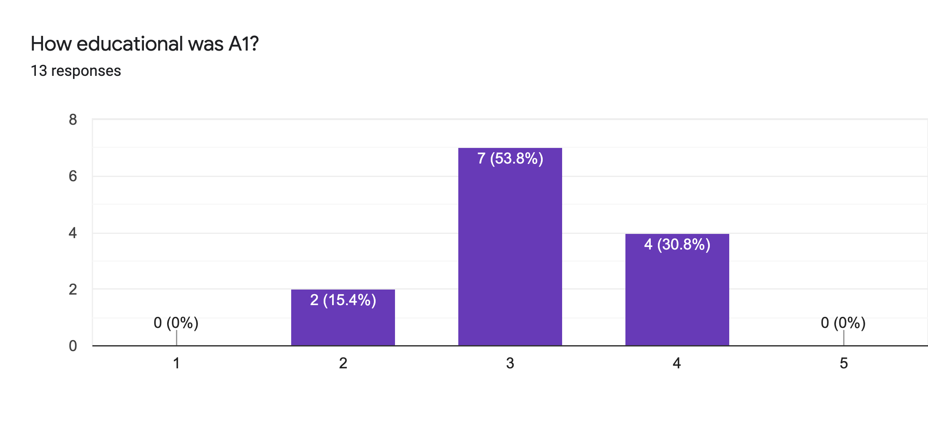
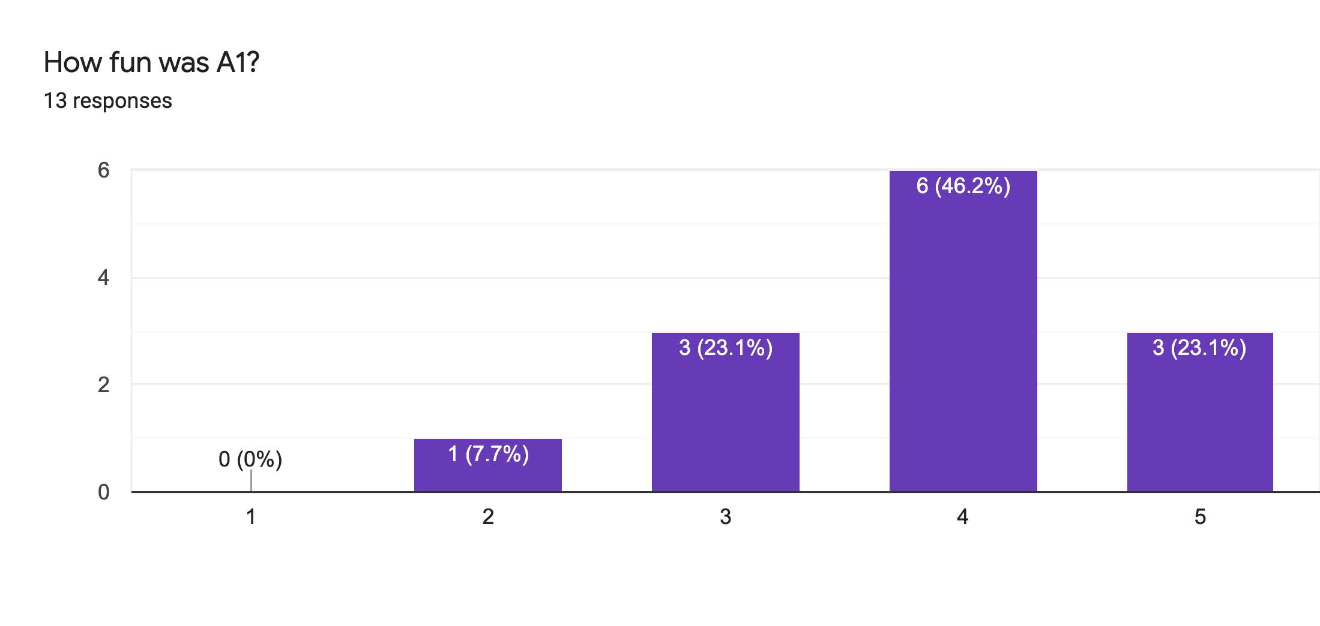
Main Comments
Vague Instructions
Bugs 🙏

Slide 10
Reviews
Strengths
Clear, honest writing
Ability to scale up/out is a big win!
Experiment design + explanation: A+

Slide 11
Reviews
Weaknesses
Lacks baselines
Aggregation?
Explain terms
How to choose partitioning key?
If scales to 1000+ nodes, what bottlenecks?
Failure on recovery?

Slide 12
Class 4

Slide 13
Do The Following
Turn video on
Type in chat or say:
A book/article I recently read
was ___ ______
3. Click when done

Slide 14

Today’s session
Finish previous class NO NEED!
Single Machine Joins.
Poll: paper reviews in pairs?

Slide 15
Today’s session
Finish previous class NO NEED!
Single Machine Joins.
Poll: paper reviews in pairs?
Poll: random pairing each week?

Slide 16
Breakout
Discussion:
Is a hot dog a sandwich? Discuss
Notetaker:
Summarize the discussion (~30s)

Slide 17
Discussion
Novelty
Theoretical guarantees
Experiment design

Slide 18
Class 3

Slide 19

Do The Following
Turn video on
Type in chat or say:
My favorite morning drink is ___ ___
(as much detail as you wish)
3. Click
Participants
Chat

Slide 20
Today’s session
Finish previous class
Multi-dimensional indexing
A1 is out, due 9/20

Slide 21
Breakout
Discussion:
Share your favorite quick cooking recipe,
or what you would like to cook
Notetaker:
Summarize the discussion (~30s)

Slide 22
Discussion
Novelty
Theoretical guarantees
Experiment design

Slide 23
Class 2

Slide 24
Turn video on,
enable mic & say:
“Hi, this is _(name)_,
I ate ___________ for breakfast”
Click when done
Participants
Chat

Slide 25
Logistics
Walk through
A0
Paper Reviews
Project list is up (still evolving)
Course goal
You feel comfortable reading papers + conducting research
Research ~ answering your own questions

Slide 26

Today’s session
Finish previous class
Review classic DBMS components
Notes on w6113.github.io

Slide 27
#ScholarStrike
Notes:
Supposed to be a two day strike where you don’t do any professor related tasks and learn about BLM and challenges of underrepresented people, and what can be done to help

Slide 28
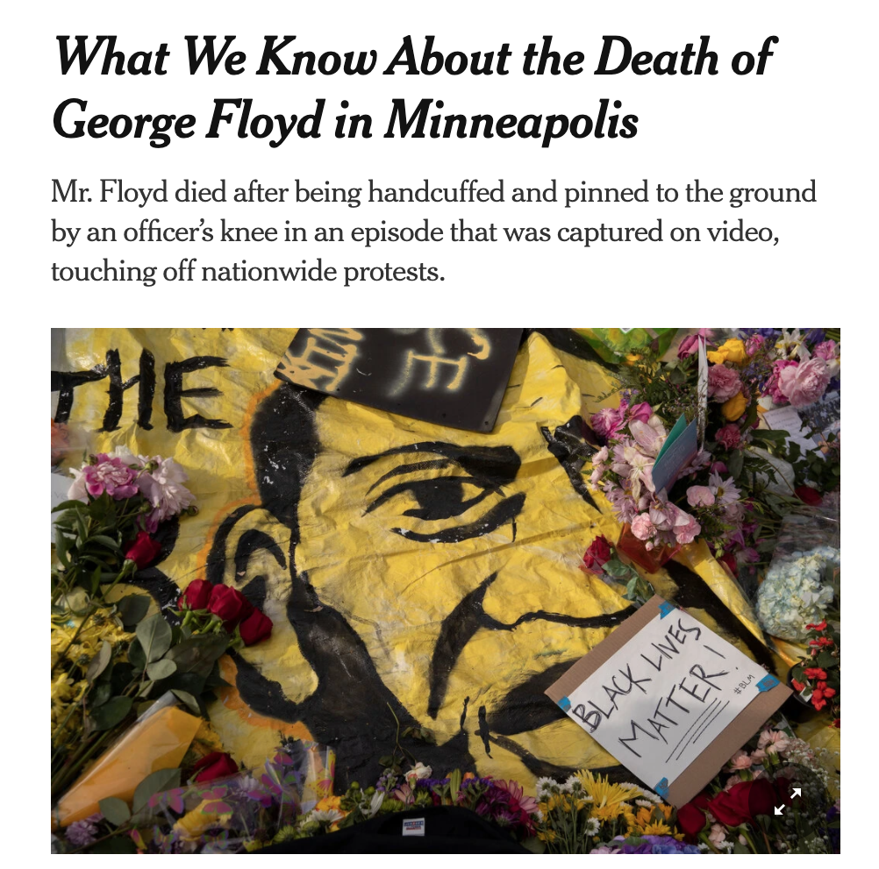
Black Lives Matter
Notes:
Discuss where all of this started and popularized this year, which, for me was the black lives matter protests.
BLM has been around for many years, but the very public, and unfair, murders of black people by police ignited the movement
For instance, geore floyd

Slide 29

Black Lives Matter
Notes:
Breonna Taylor was a nurse just at home in her apartment

Slide 30
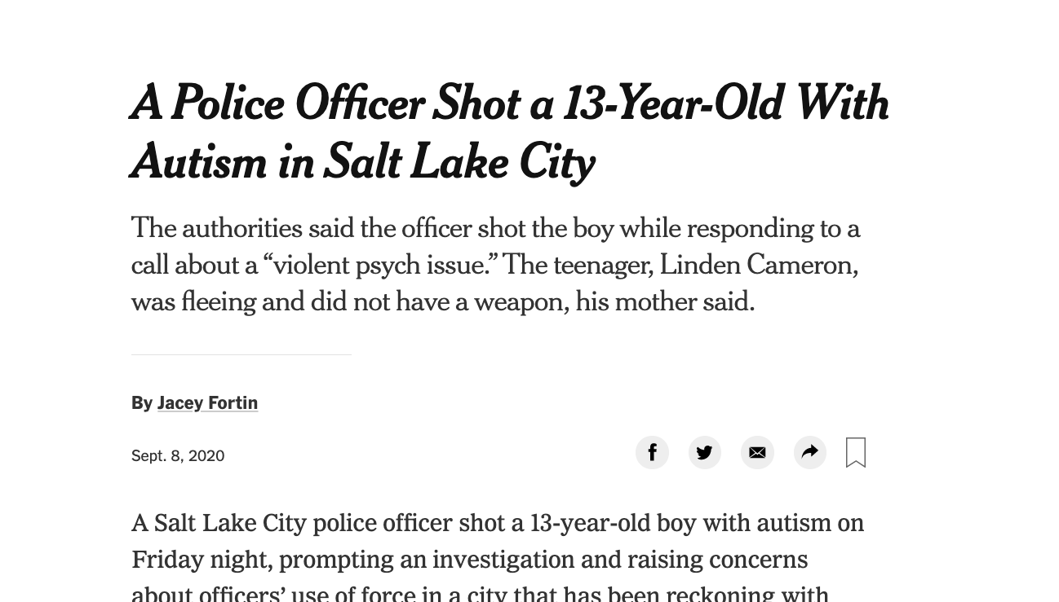
Black Lives Matter
Notes:
Linden Cameron was a 13 year old shot in the back

Slide 31
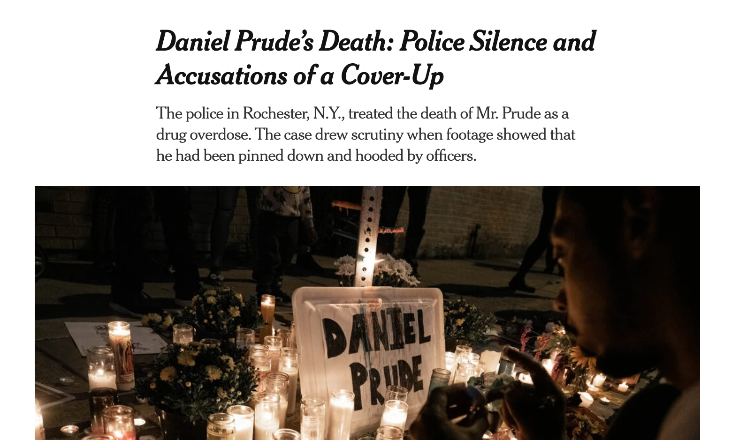
Black Lives Matter
Notes:
And Daniel Prude who was pinned and hooded by officers, who then blamed it on drug overdose, which leverages deep seated biases about black people.
These events are tragic, and simply symptoms of a deep disparity between African americans and the rest of America.
The US has historically treated immigrants of all kinds poorly, but African americans have been systematically oppressed from day one of the nation’s founding.
BLM is simply the manifestation of the outrage at this inequity

Slide 32

Notes:
Recently the WNBA led the sports world in going on a strike to further publicize this issue, and other sports leaguse followed.
ScholarStrike was a reaction by academics in support of this

Slide 33
Search terms to learn more
john oliver police
Netflix 13th
The case for reparations
shutdownstem
Notes:
Rather than cancel class, I’ll list here terms that are worth searching for to educate your self a bit about what’s going on. We will share these terms in the slack.
These are issues that I am not an expert in either, but I am happy to discuss these in recitation or OH.

Slide 34
Your Tasks for next class
Submit reviews for Tuesday
Submit Assignment 0 by 9/13 11:59PM EST
w6113.github.io

